Slide 1
Loan Campaign Modelling Project

Slide 2
Contents
Background & Problem Statement
Data Dictionary
Exploratory Data Analysis Highlights
Model Performance Summary
Recommendations

Slide 3
Background & Problem Statement

Slide 4
There is a growing customer base for AllLife Bank, especially in liability customers.

Slide 5
The management wants to explore ways of converting its liability customers to personal loan customers.
while at the same time, retaining them as depositors

Slide 6
We require a model that can predict potential customers who have a higher probability of purchasing the loan.
Here, logistic regressions and decision trees will be used.

Slide 7
Data Dictionary
The data contains information about 5000 customers and their characteristics. No further pre-processing is needed to the data, other than erroneous negative values in work experience.

Slide 8
Variable | Description
ID | Customer’s ID
Age | Customer’s age in completed years
Experience | Number in years of professional experience
Income | Annual income of the customer (in thousand dollars)
ZIP Code | Home Address ZIP code
Family | Family size of the customer
CCAvg | Average spending on credit cards per month (in thousand dollars)
Education | Education Level (1: Undergrad; 2: Graduate; 3: Advanced/Professional)
Mortgage | Value of house mortgage if any (in thousand dollars)
Personal_Loan | Did this customer accept the personal loan offered in the last campaign?
Securities_Account | Does the customer have securities account with the bank?
CD_Account | Does the customer have a certificate of deposit (CD) account with the bank?
Online | Do customers use internet banking facilities?
CreditCard | Does the customer use a credit card issued by any other Bank (excluding All life Bank)?

Slide 9
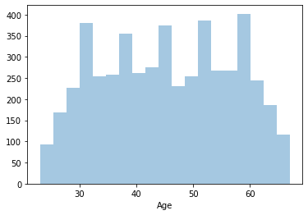
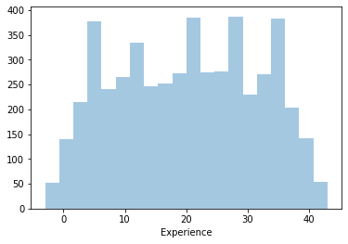
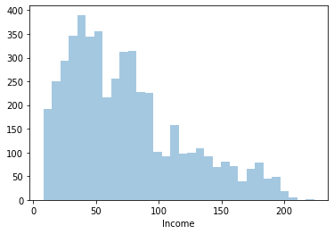
Exploratory Data Analysis Highlights
Age and Experience have a similar distribution
Income is right skewed

Slide 10
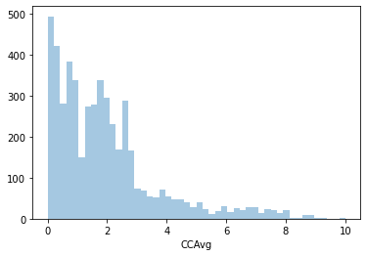
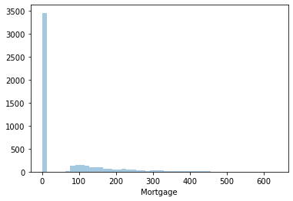
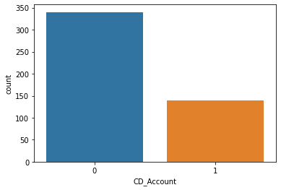
Exploratory Data Analysis Highlights
CCAvg is right skewed
Most people have 0 in mortgage amount
Most of the customers don't have a certificate of deposit (CD) account with the bank

Slide 11
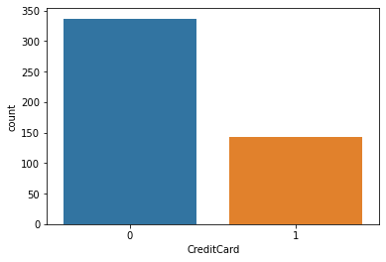
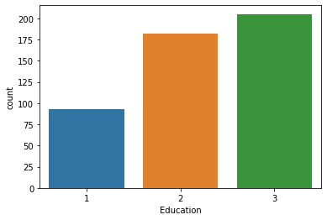
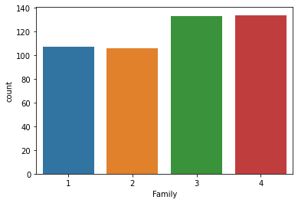
Exploratory Data Analysis Highlights
Most of the customers do not use a credit card issued by any other Bank (excluding All life Bank)
Most of the customers' last education are as undergraduates
Most of the customers have only 1 other family member

Slide 12
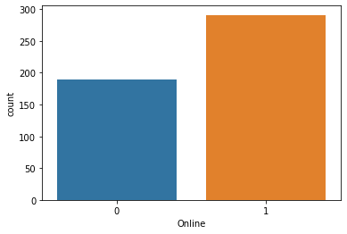
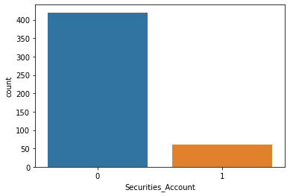
Exploratory Data Analysis Highlights
There are more customers using internet banking facilities
Most of the customers don't have security account with the bank

Slide 13
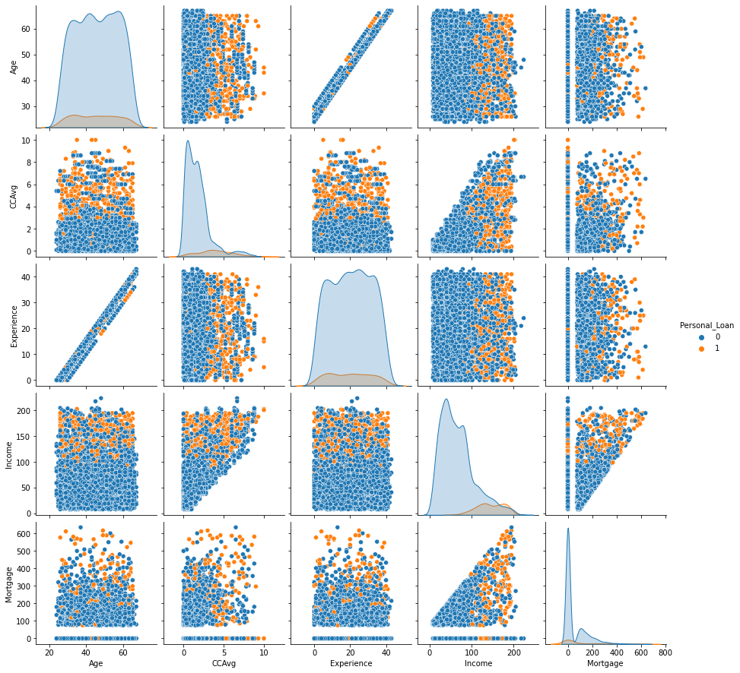
Exploratory Data Analysis Pairplot

Slide 14
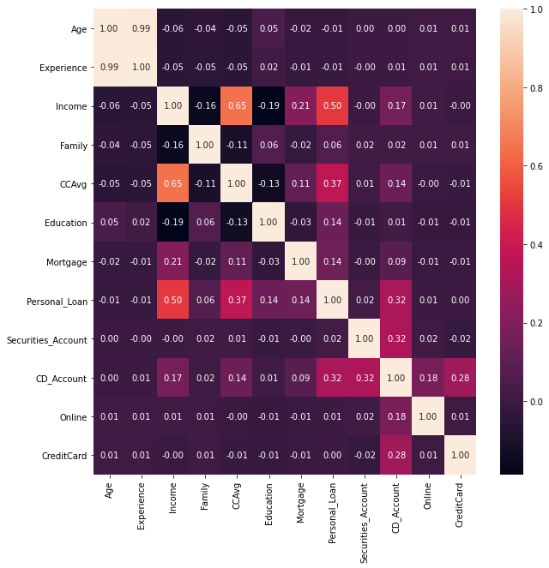
Exploratory Data Analysis Heatmap

Slide 15
Exploratory Data Analysis Highlights
CCAvg somewhat correlates with Income.
The target variable Personal_Loan is mostly correlated to Income, followed by CCAvg and then CD_Account.
Age and experience correlate strongly
From bivariate analysis,
Those who accepted the loan are people who have higher income levels
Those who accepted the loan has somewhat higher CCAvg values

Slide 16
Model Performance Summary
Both logistic regression and decision tree models are applied, with 70% of data used as training data and 30% of data used as testing data
Recall is used as the main indicator of the models, as we want to avoid having false negatives, which severely impact the company
The experience column is removed due to its very high correlation to the age column, leading to multicollinearity

Slide 17
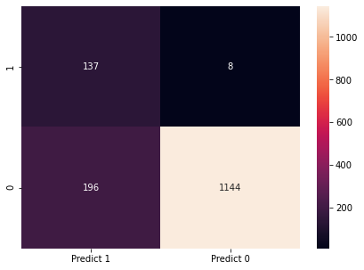
Logistic Regression
Among various logistic regression models applied, logistic regression model with threshold value adjustment is the most ideal model that can be used due to a high value in recall.
Model | Recall
Basic Logistic Regression Model | 0.58
Logistic Regression Model with Threshold Value Adjustment | 0.95
Logistic Regression with Statsmodel | 0.68

Slide 18
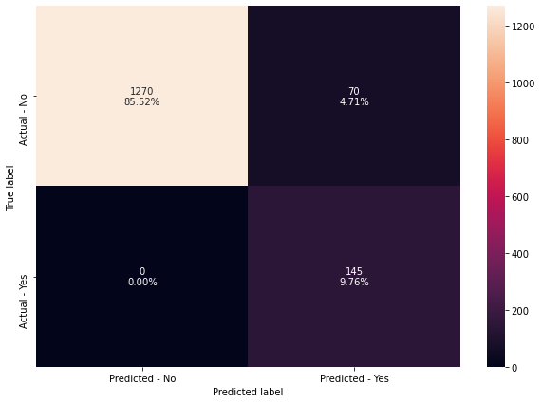
Decision Tree
Among various decision tree models applied, decision tree with post-pruning has the highest recall and hence is the most ideal model that can be used for prediction.
Model | Train_Recall | Test_Recall
Basic Decision Tree Model | 1.00 | 0.87
Pre-pruned Decision Tree with max depth of 3 | 0.84 | 0.83
Pre-pruned Decision Tree with Hyperparameter Tuning | 0.98 | 0.96
Decision Tree with Post-pruning | 1.00 | 1.00

Slide 19
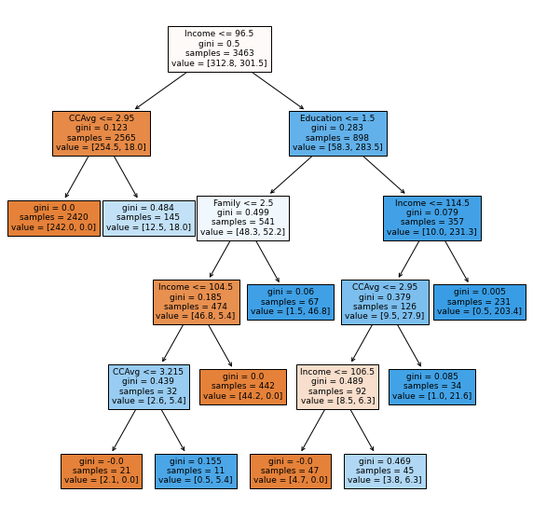
Best Decision Tree Model

Slide 20
Most Important Predictors
1st : Income
2nd : Family
3rd : Education
4th : CCAvg

Slide 21
Recommendations to Marketing Team (ordered by priority)
To target people with higher income, with at least around 130
To target people with another family member (married couples, with or without children)
To target people with the education level as a graduate or advanced/professional
To target people with higher level of average credit card spending/month, at least 2.5 or above
To target people with no mortgage value

